Slide 1
accessibility for SELF-SERVICE publishers
Michael "Spell" Spellacy: Director, Accessibility
Rebecca Hammer: Senior UI Developer

Slide 2
WHY IS Accessibility IMPORTANT?
Over 15% of the world population is disabled – 1 billion people! (WHO)
Aging Job Market - Americans 55 and over hold nearly 25% of all jobs. (CNBC)
A potential candidates first impression of a company is important and should be a positive experience for everybody. EOE begins with TMP!
Clients expect us to reach ALL potential candidates!
Risk of Litigation – Over 5,000 web accessibility lawsuits will be filed under ADA in 2020 – Up from 50 in 2014! (Level Access)

Slide 3
WHAT Can we do?
Make accessibility a priority! Talk to clients about their policies and expectations surrounding accessibility.
Practice inclusive design and development and speak to accessibility throughout entire process.
Test! Test! Test! – No site considered conformant unless it is tested against WCAG.
Knowledge Sharing – The more we all know, the more inclusive thinking TMP becomes (and the easier all the above gets).

Slide 4
Most common issues in web publishing:
Headings
Hyperlinks
Alternative Text

Slide 5
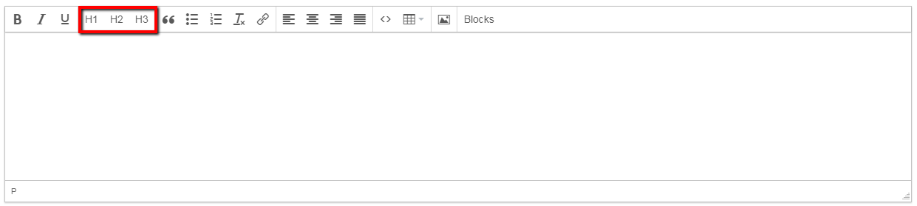
Self-Service Publishing
Page Headings

Slide 6
Self-Service Publishing
Page Headings
Headings represent the hierarchical structure of the page's content.
Headings are used by various assistive technology users to help navigate the page.
A heading must never be selected for its size. Choose the right heading level and use CSS to style to your design needs. Structure greater than asthetics.
Headings may never skip levels.

Slide 7
Self-Service Publishing
Page Headings
Headings may be nested.
Avoid using more than one h1 element.
The h1 element should loosely match the title of the page. (Try your best.)

Slide 8
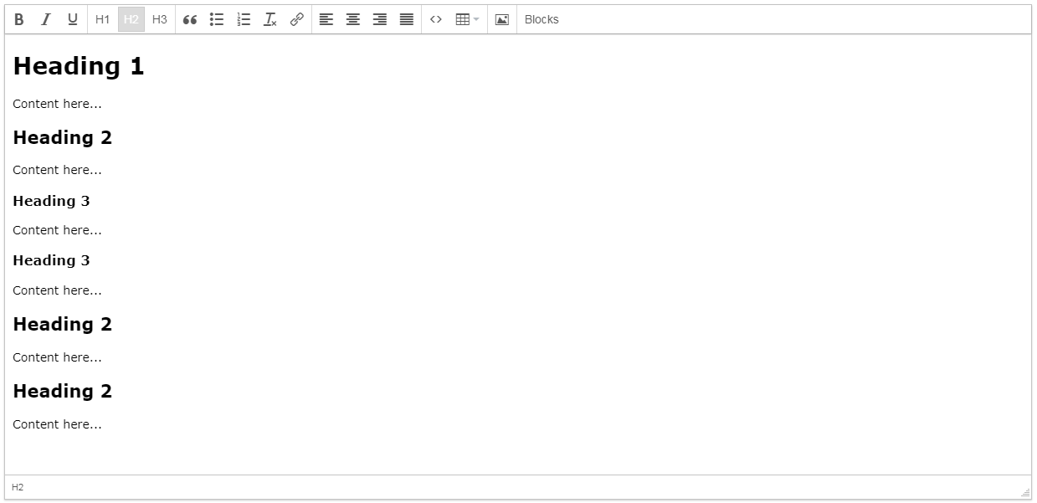
Self-Service Publishing

Slide 9
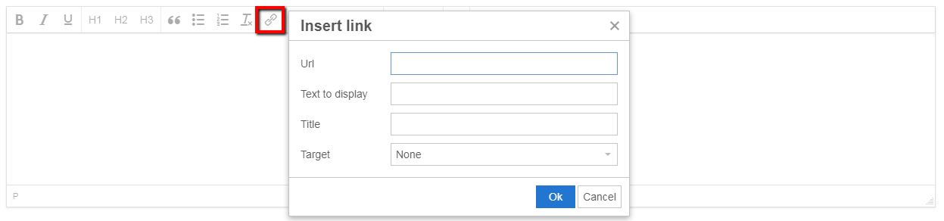
Self-Service Publishing
Hyperlinks

Slide 10
Self-Service Publishing
Hyperlinks
Assistive technology users depend on hyperlinks to navigate.
Good hyperlinks provide context. Link relevant word, words or phrases.
Avoid linking terms like "click here" or "here", etc.
Many other elements, such as headings and images can contain hyperlinks. (More on images shortly.)

Slide 11
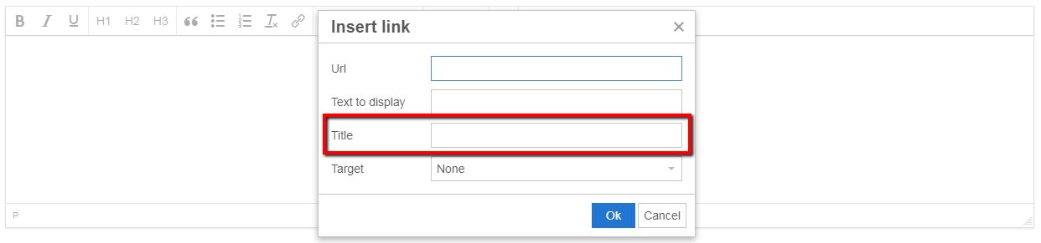
Self-Service Publishing
Hyperlinks: Title Attribute
Avoid the "Title" field. This adds a useless tooltip to the link that mobile
devices and assistive technologies don’t even use. No proven benfit for SEO.

Slide 12
Self-Service Publishing
Hyperlinks: New Windows (Tabs)
Hyperlinks that open in new windows should be approached with caution.
Poor implementation of them can have negative effects on Accessibility, UX, Performance and Security!
Ask yourself if you really need a new window.
Share this advice with clients.

Slide 13
Self-Service Publishing
Hyperlinks: New Windows (Tabs)
More details on new windows:
https://michaelspellacy.com/the-last-word-on-opening-new-windows/

Slide 14
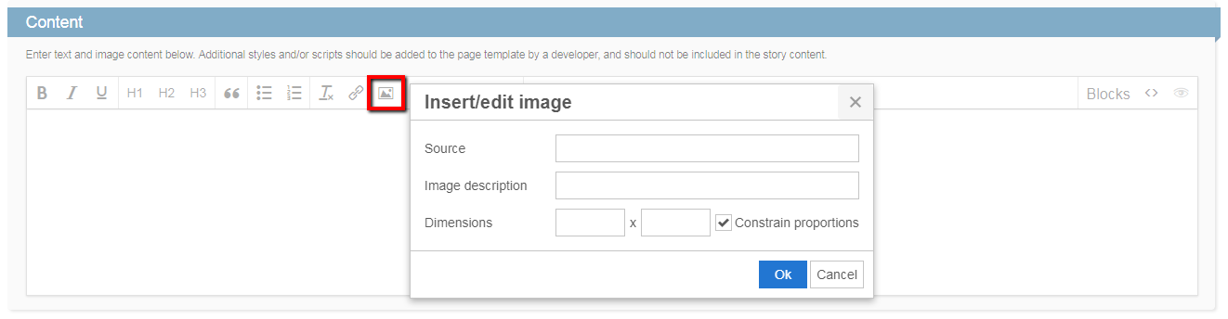
Self-Service Publishing
Alternative Text

Slide 15
Self-Service Publishing
Alternative Text
Not all images require alternative text. There are two kinds of images: Informative and Decorative.
If image is relevant to or supplements surrounding content, then it is considered informative and should contain alternative text.
Decorative images are often icons, branded page dressing or other design flourishes.

Slide 16
Self-Service Publishing
Alternative Text
Alternative text should succinctly describe an image.
Avoid terms like "Picture of..." or "Image of..." within alternative text.
Logos and images with embedded text must contain verbatim alternative text.
Avoid keyword stuffing alternative text values. Alternative text is for people, not search engines.

Slide 17
Self-Service Publishing
Alternative Text: Images in Hyperlinks
Single images wrapped within hyperlinks must contain alternative text, even if they are decorative. However, the text would be more functional in nature:
<a href="…">
<img src="…" alt="My Summer Vacation (Video)">
</a>

Slide 18
Self-Service Publishing
Alternative Text: Images in Hyperlinks
The only exception to this rule is if adjacent or nearby text is present within the link:
<a href="…">
<img src="…" alt="">
<p>My Summer Vacation</p>
</a>

Slide 19
Self-Service Publishing
Alternative Text
When in doubt, use the Alt Decision Tree:
https://www.w3.org/WAI/tutorials/images/decision-tree/
More on Informative & Decorative Images:
https://www.w3.org/WAI/tutorials/images/informative/
https://www.w3.org/WAI/tutorials/images/decorative/

Slide 20

THANK YOU! a11y@TMP.com
Notes:
Our UX/A11y Implementation page on the intranet will be updated in the coming weeks to show the workflows and steps we take to make sure sites are more accessible.

